Slide 1


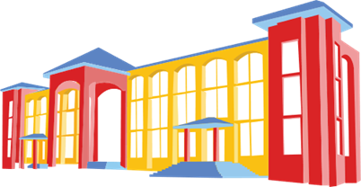

Welcome to

Slide 2
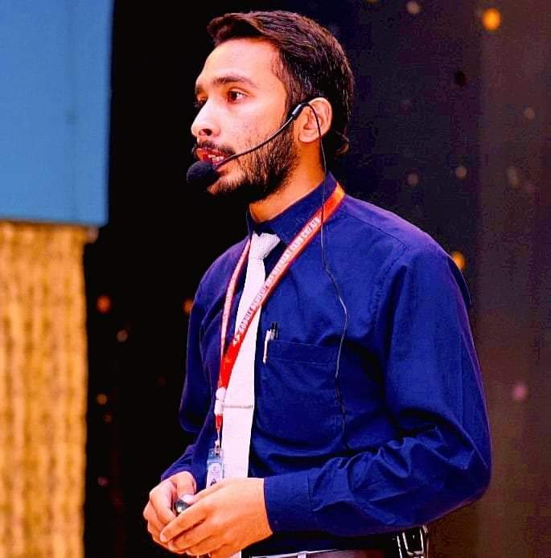
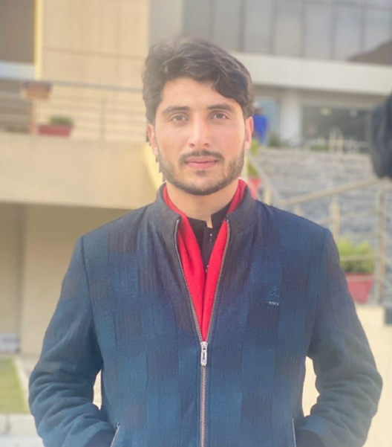
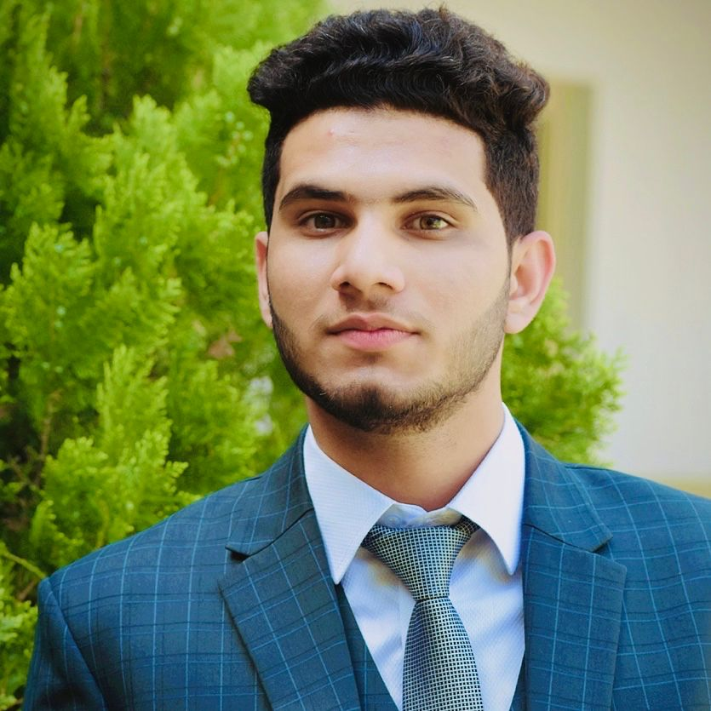
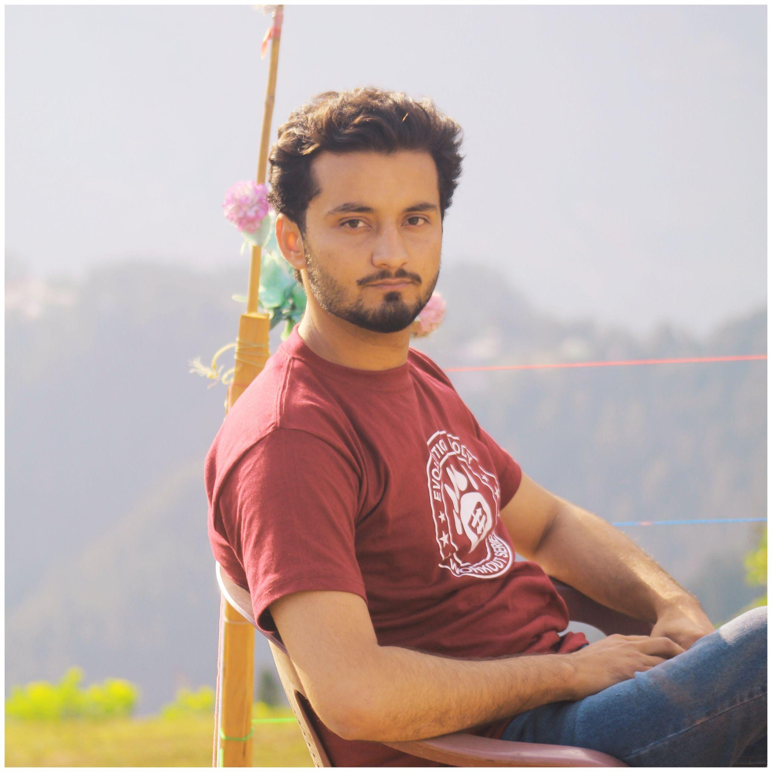
Team AgriTech
M.Raees Azam
COMSATS University Abbottabad
Muneer Hasan
COMSATS University Abbottabad
Hammad Ali Khan
COMSATS University Abbottabad
M. Awais Khan
COMSATS University Abbottabad

Slide 3
Problem Statement
crop diseases are a significant threat in Pakistan same as all over the world with annual losses amounting to millions of tons of crops.
15-20% losses
For instance, wheat rust alone leads to
losses of 15-20%.
Therefore, an AI-based crop monitoring system Called AgriTech is desired to reduce the impact of crop diseases along with optimized resource utilization and decreased human health risks in agricultural sector.
20,000 cases ( Only in PAK)
pesticide-related illnesses are common with approximately 20,000 cases reported annually in Pakistan.

Slide 4
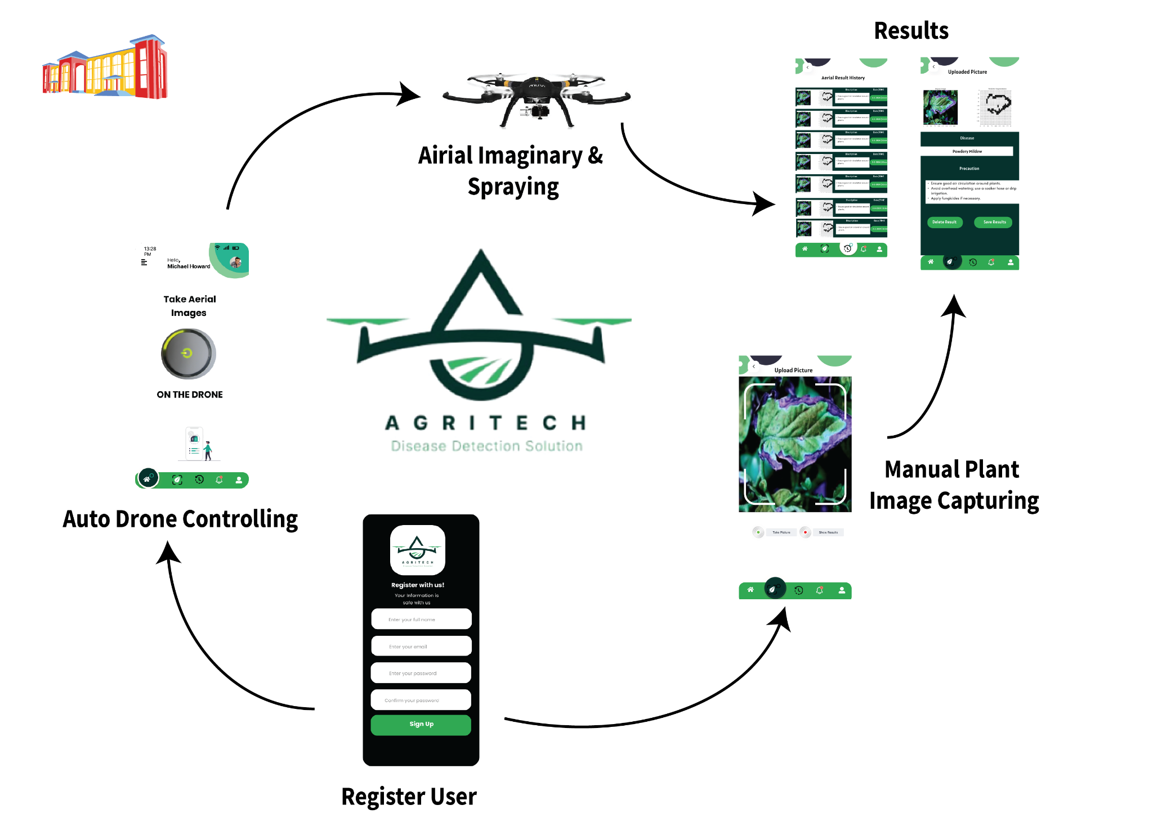
System Architecture

Slide 5




Targeted SDGs
AgriTech's solutions help improve crop health, enhancing farmer livelihoods and contributing to poverty reduction.
AgriTech promotes safer farming practices by minimizing pesticide exposure, benefiting farmers' health.
By reducing crop losses, AgriTech supports efforts toward achieving zero hunger.
AgriTech optimizes resource use, promoting sustainability in agriculture.

Slide 6
DEMO
Story:
A Farmer( Jaffer Malik ) is standing on his field and looking at the field while coughing and doing spray on field than Muneer Went to him and told him about Our Drone & About Mobile App.
A Farmer will start Drone by Clicking on the Start Drone Button and Drone will fly and spraying the Field autonomously ( will Add here UI Design of Start button video than add drone spraying video)
Than Muneer Also tell him that he can get plants disease results on his mobile phone also and for taking a specific plants health condition he can directly take picture of that.( Will add here the UI Design Video of Uploading Picture Results)

Slide 7
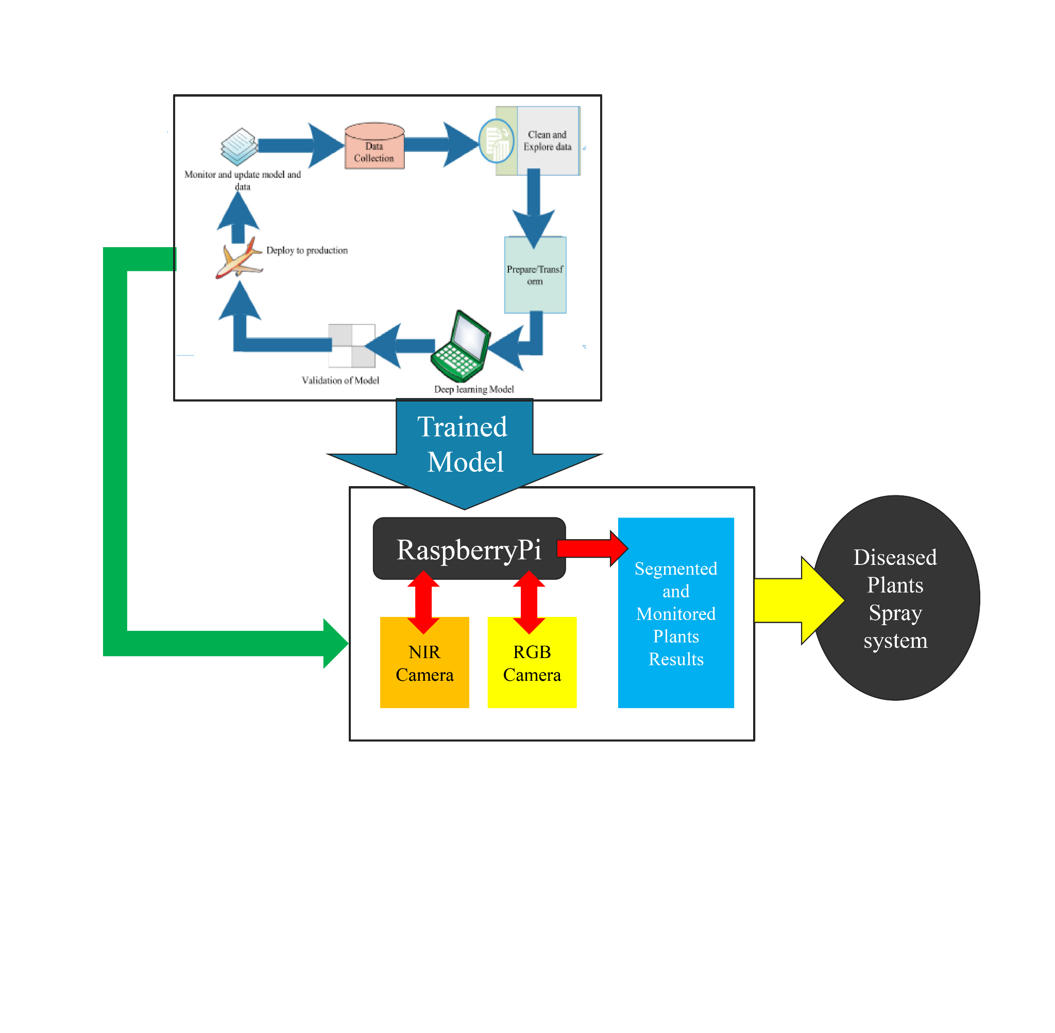
AgriTech Flow Diagram

Slide 8
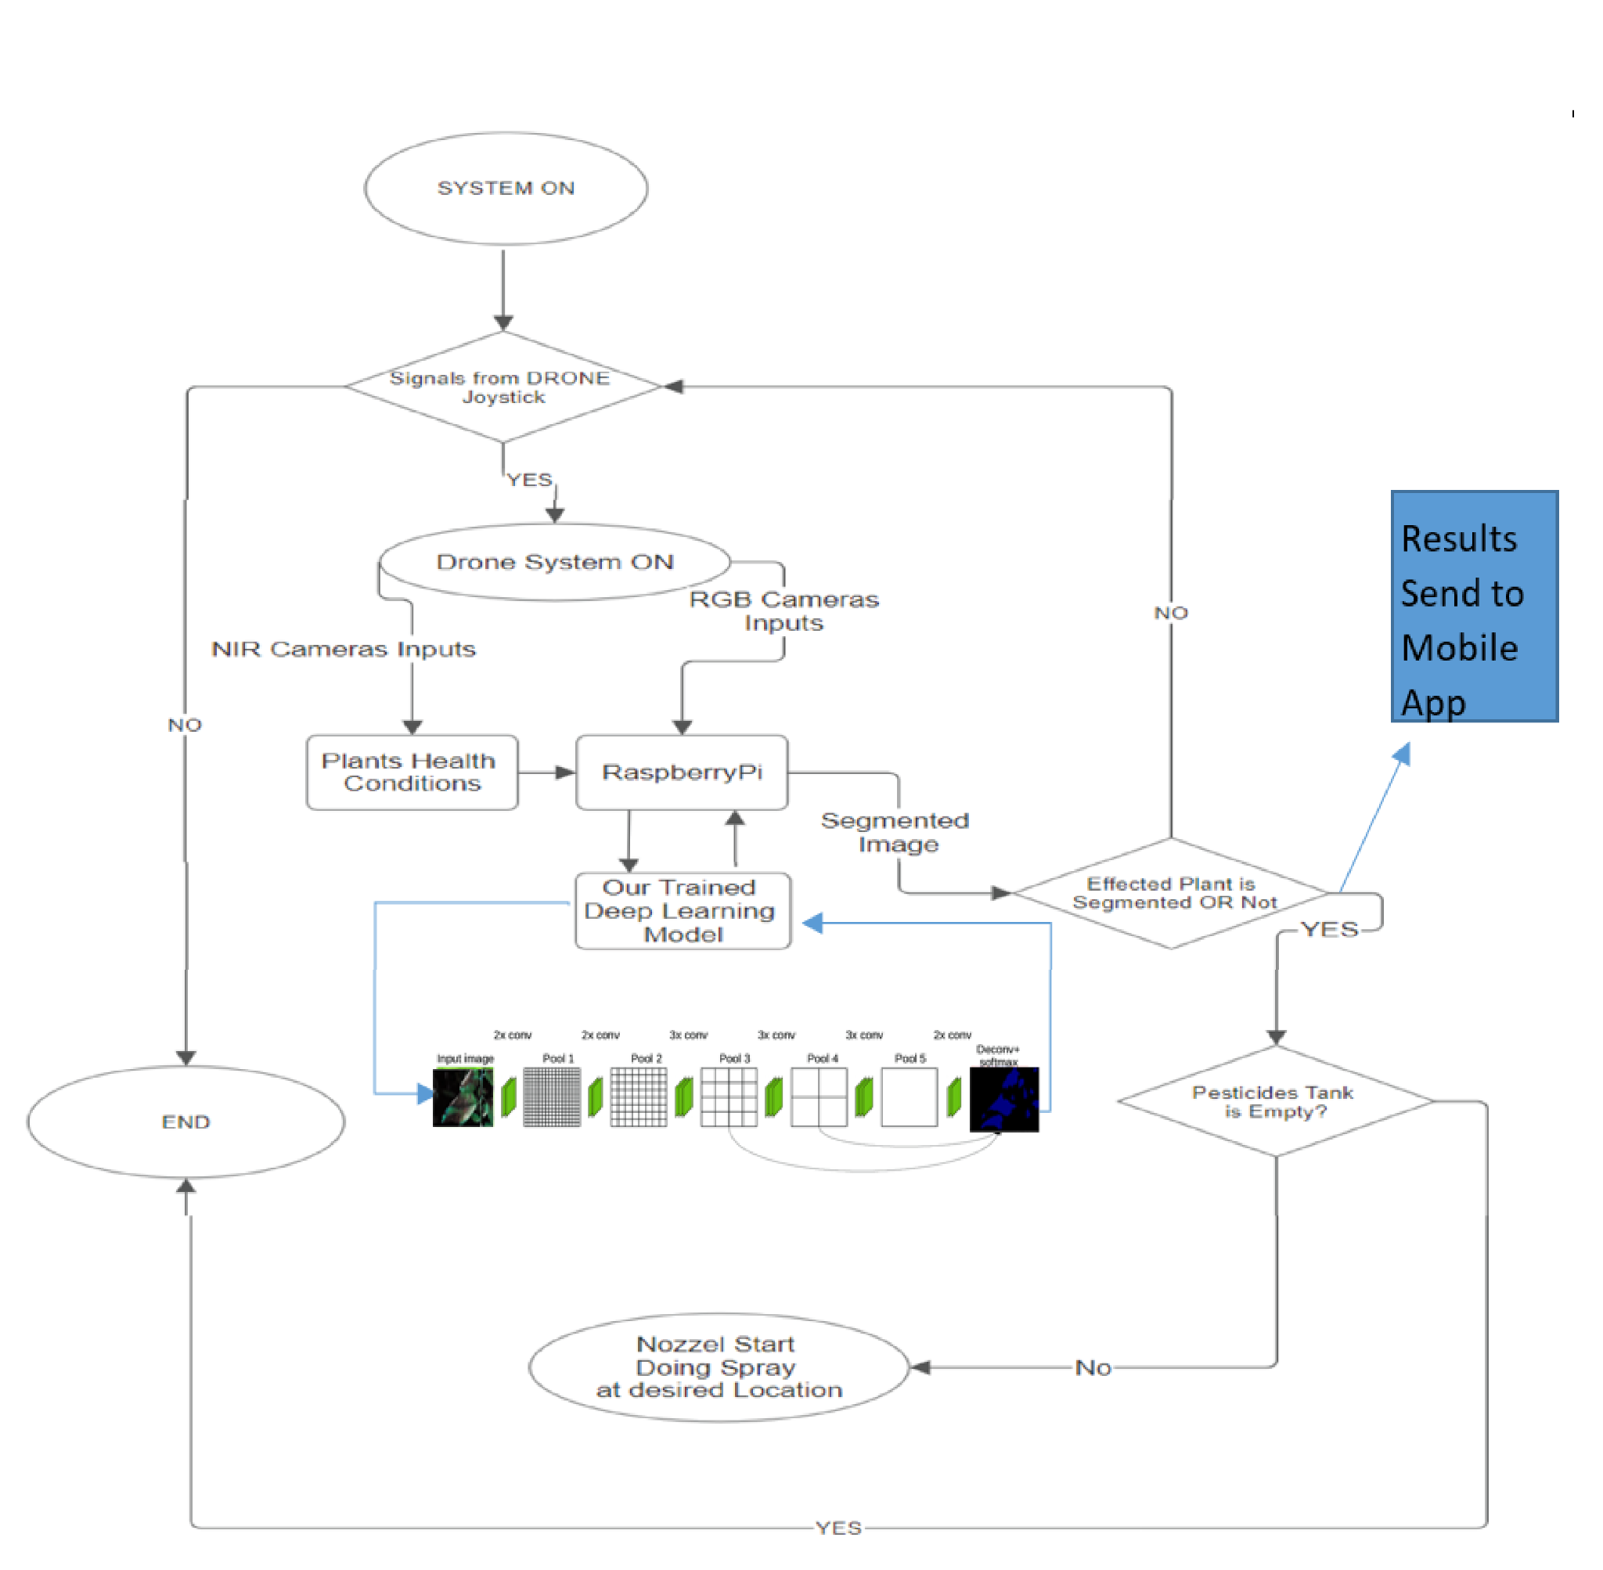
System Flow Diagram

Slide 9
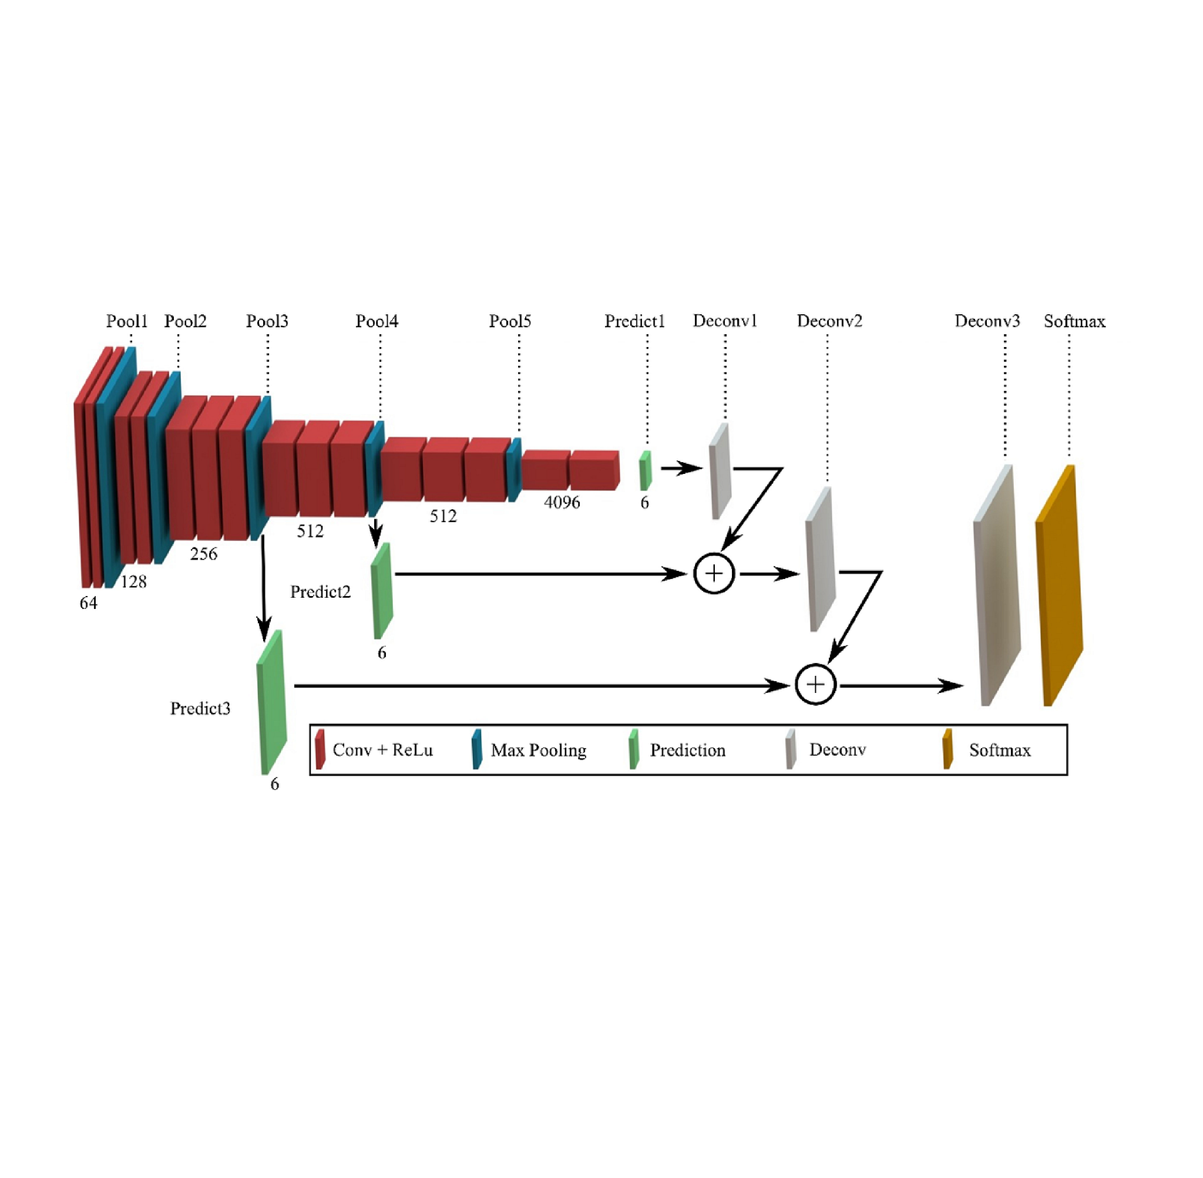
Algorithm Architecture

Slide 10
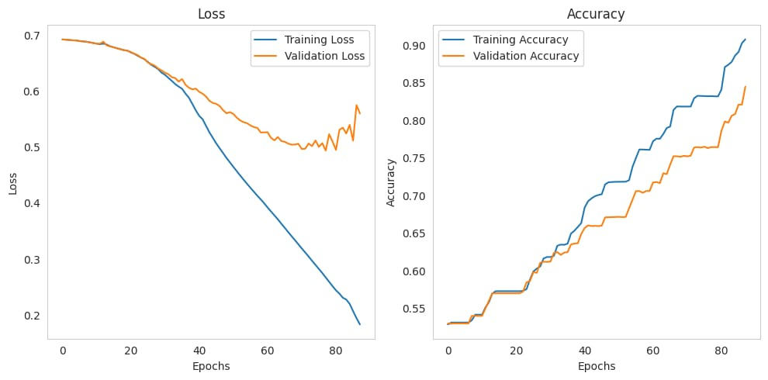
Results & Accuracies

Slide 11
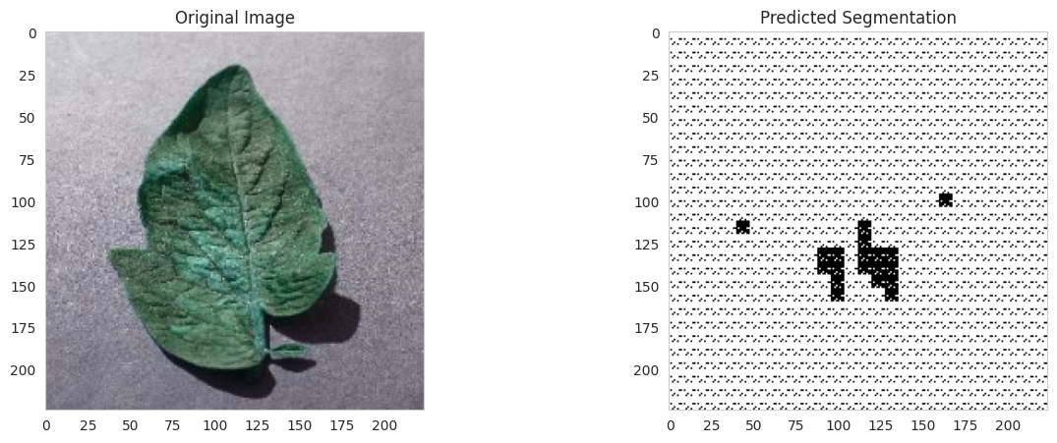
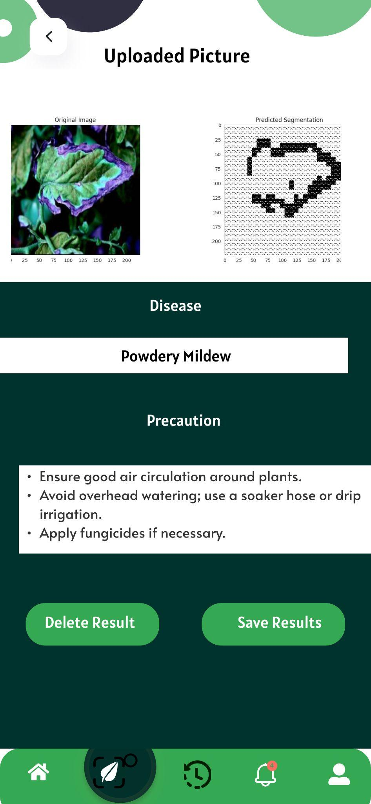
Results & Accuracies
Test on Tomato Plant: Issue: Spider_mites Two-spotted_spider_mite
Solution: Prune affected leaves, manage weeds, and water properly.

Slide 12









Technology Stack
Debian used to Powers the Raspberry Pi for reliable in-field computations.
For collaborative AI model development and training.
An easy-to-use Python IDE for software development on Raspberry Pi.
To develop a cross-platform mobile application for farmers to monitor crop health.
For building and deploying machine learning models that analyze crop images
Writing Python code for making Deep Learning algos
For real-time data storage, user authentication, and notifications.
Is used to do Deep learning Algoriyhms on Hardware side implementation
Using notebook styling for cell to cell executions

Slide 13
